Slide 1
Unit 12 Capacitors
Part B: Charging and Discharging
Processes of Capacitors

Slide 2
What will we learn?
The charging process of capacitor
The discharging process of capacitor

Slide 3
How a Capacitor Stores Charges
In neutral (uncharged) state, both plates of a capacitor contain equal number of electrons.

Slide 4
How a Capacitor Stores Charges
The charging process…
Plate A
Plate B
When connected to a voltage source,
Plate A: electrons removed
Plate B: electrons deposited
+
V_{S}
Plate A loses electrons → becomes more positively charged.
Plate B gains electrons → becomes more negatively charged.
Capacitor gets increasingly charged.
During this process, electrons flow through the connecting leads and the voltage source.

Slide 5
How a Capacitor Stores Charges
Plate A
Plate B
+
v_{C}
Insulating dielectric
Electron movement stops at the plates because they cannot flow through the insulating dielectric.
Voltage builds up across plates.
+
V_{S}
=
Movement of electrons stops when voltage across capacitor equals source voltage, Vs. The external source cannot move charge any more: the capacitor is now fully charged.

Slide 6
How a Capacitor Stores Charges
If capacitor is now disconnected from source, it can retain the stored charge for a long time.
A capacitor with stored charge can act as a temporary battery.
+
V_{S}
−
Plate A
Plate B
Charges still stored
+
V_{S}

Slide 7
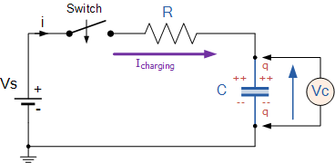
RC Charging Circuit

Slide 8

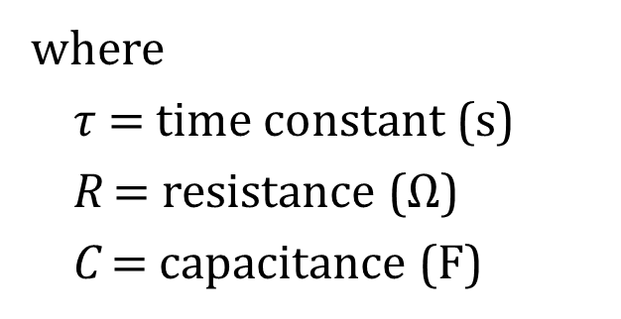
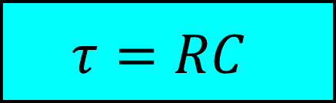
Time Constant & Charging Curves
Time is required for a capacitor to charge or discharge fully.
Amount of time required depends on time constant $τ$ of the circuit.
Greek letter, tau
$$τ=RC$$
where
$τ$ = time constant (s)
R = resistance (Ω)
C = capacitance (F)

Slide 9
Time Constant & Charging Curves
τ is the amount of time required to charge a capacitor to approximately 63% of its final value.
At time = 5τ, capacitor can be considered to be fully charged.
Note that every capacitor circuit has some amount of resistance present.

Slide 10


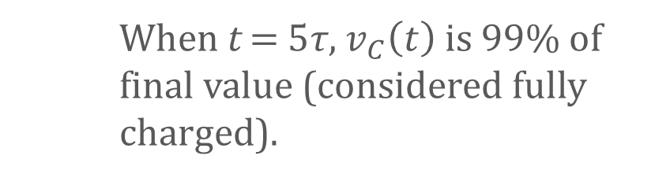
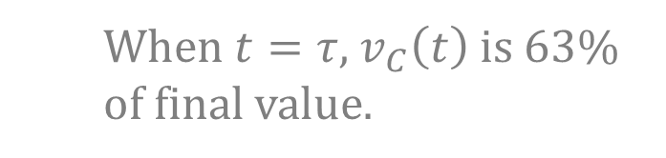


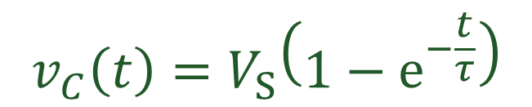

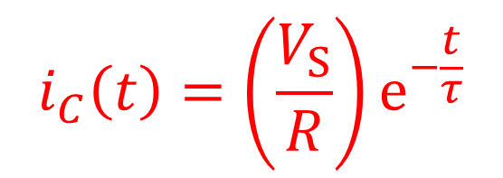
Graphical Plot of Charging Curves
$$i_{C}\left(t\right)=\left(\frac{V_{S}}{R}\right)e^{−\frac{t}{τ}}$$
$$v_{C}\left(t\right)=V_{S}\left(1−e^{−\frac{t}{τ}}\right)$$
$$τ=RC$$
$$v_{C}\left(t\right)$$
$$or i_{C}\left(t\right)$$
$$i_{C}\left(t\right)$$
98%
99%
Capacitor voltage during charging
95%
$$v_{C}(t)$$
86%
63%
When t = 5τ, $v_{C}\left(t\right)$ is 99% of final value (considered fully charged).
Capacitor current during charging
When $t=τ$, $v_{C}\left(t\right)$ is 63% of final value.
0 τ 2τ 3τ 4τ 5τ
t

Slide 11
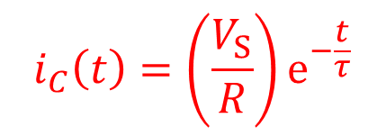
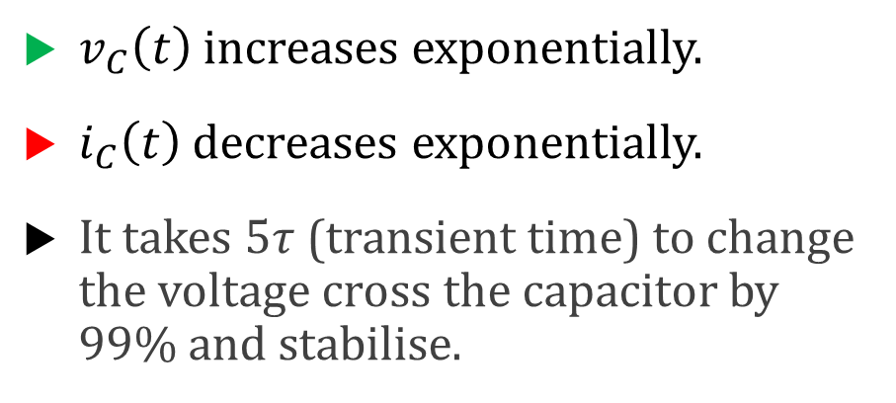


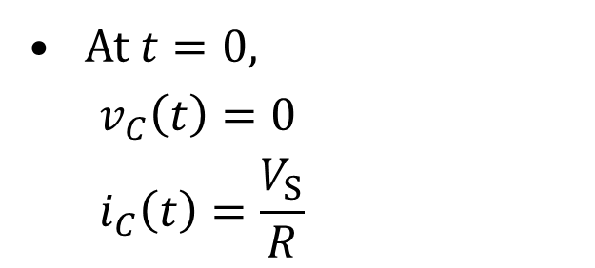
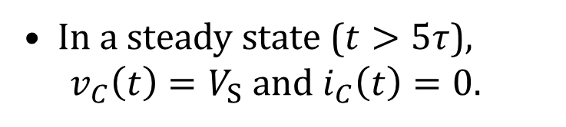
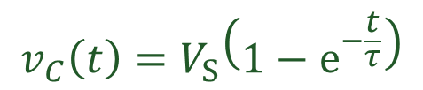
Graphical Plot of Charging Curves
$$v_{C}\left(t\right)=V_{S}\left(1−e^{−\frac{t}{τ}}\right)$$
$v_{C}\left(t\right)$ increases exponentially.
$i_{C}\left(t\right)$ decreases exponentially.
It takes $5τ$ (transient time) to change the voltage cross the capacitor by 99% and stabilise.
98%
99%
$$i_{C}\left(t\right)$$
95%
$$v_{C}(t)$$
86%
63%
$$i_{C}\left(t\right)=\left(\frac{V_{S}}{R}\right)e^{−\frac{t}{τ}}$$
In a steady state ($t>5τ$),
$v_{C}\left(t\right)=V_{S}$ and $i_{C}\left(t\right)=0$.
0 1τ 2τ 3τ 4τ 5τ t
A fully charged
capacitor appears
as an open circuit
At $t=0$,
$$v_{C}\left(t\right)=0$$
$$i_{C}\left(t\right)=\frac{V_{S}}{R}$$
An uncharged
capacitor appears
as a short circuit

Slide 12
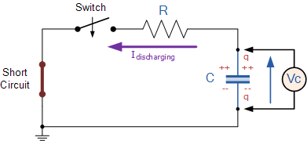
RC Discharging Circuit
Direction of current
Discharge current opposite that of Charging current
When switch S closes, excess electrons move from plate B to plate A
Energy stored in an electric field by capacitor is converted back into discharging electric current
During charging and discharging, current flows from one plate to another only through the external circuit

Slide 13
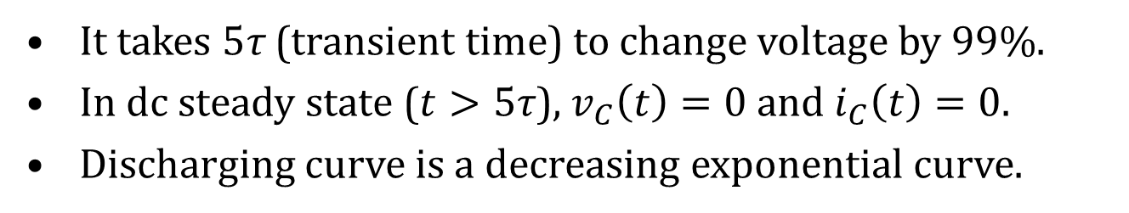
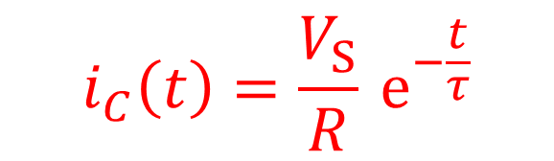
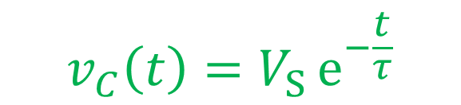
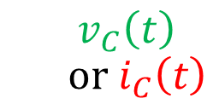
Graphical Plot of Discharging Curves
$$v_{C}\left(t\right)$$
$$or i_{C}\left(t\right)$$
100%
$$v_{C}\left(t\right)=V_{S} e^{−\frac{t}{τ}}$$
$$i_{C}\left(t\right)=\frac{V_{S}}{R} e^{−\frac{t}{τ}}$$
At t = τ, voltage or current is 63% of journey to zero.
At t = 5τ, voltage or current is 99% of journey to zero.
37%
14%
5%
2%
1%
0 τ 2τ 3τ 4τ 5τ
t
It takes 5τ (transient time) to change voltage by 99%.
In dc steady state ($t>5τ$), $v_{C}\left(t\right)=0$ and $i_{C}\left(t\right)=0$.
Discharging curve is a decreasing exponential curve.

Slide 14
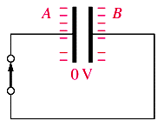
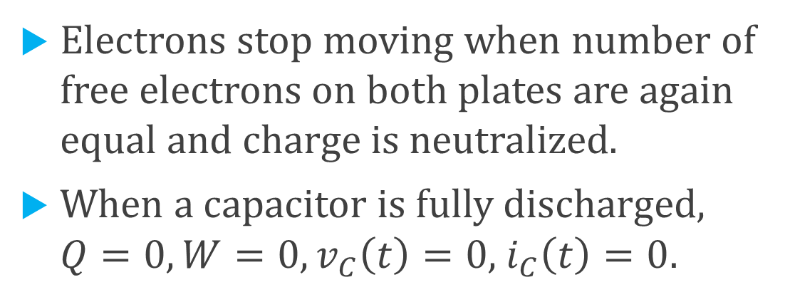
RC Discharging Circuit
Electrons stop moving when number of free electrons on both plates are again equal and charge is neutralized.
When a capacitor is fully discharged, $Q=0, W=0, v_{C}\left(t\right)=0,$ $i_{C}\left(t\right)=0$.

Slide 15
You have learned about
how a capacitor store charges,
the circuits, curves and equations of charging and discharging a capacitor, and
the time constant and how it relates to the charging and discharging curves.

Slide 16
Coming Up Next
Analyse Capacitors Connected in Series and Parallel Circuits

